Slide 1
CHICAGO FOOD INSPECTION

Slide 2


INTRODUCTION
According to statistics from the World Health Organization, in a given year, almost one in ten people fell ill from eating contaminated food, and more than 420,000 died from food-borne diseases. With the development of the economy, food safety has become a hot spot of social concern. Effectively targeting food establishments with seriously violate food regulations is the primary task of public health.
The objective of this project is to help the Food Inspection Agency develop tactical work plans through the use of data analysis methods to guide inspection activities in a more consistent and effective manner while targeting the riskiest areas in order to prevent the occurrence of food-borne illness.

Slide 3

OBJECTIVE
Evaluate the trend of changes in the safety of Chicago’s major food sectors from 2010 to 2020.
Find out regular relationships based on data and analyze them.
Applying location analysis to identify pattern and relationship

Slide 4

BENEFITS
IMMEDIATE BENEFIT: REDUCING TIME
30%
Reduce the time required for inspection. Fewer inspections mean time saved that can focus on improving competitiveness in Chicago.
Time Saving
When more problems can be discovered and resolved faster through data analysis, inspections can be performed faster. Quickly find the immediate areas of poor hygiene. This saves time for checking. Can also save money by reducing errors and downtime.
20%
Saving Money

Slide 5
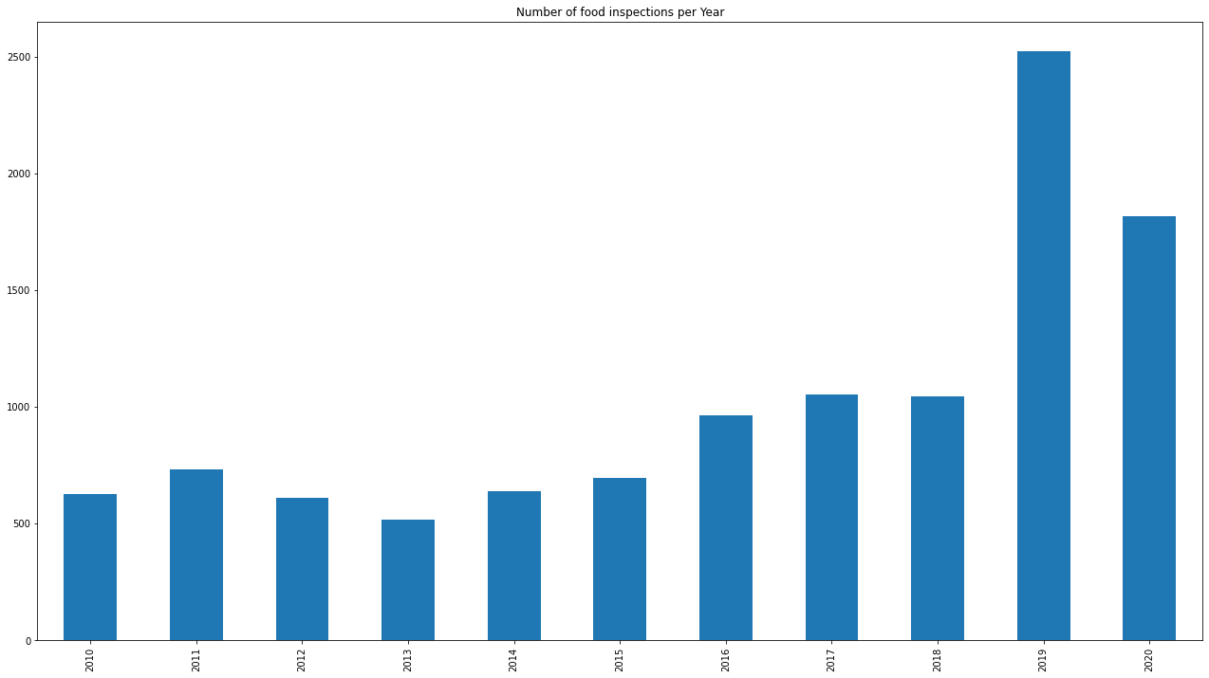
Number of food inspection per Year
This plot shows the number of inspections per year 2010 to 2020. From the figure below, we can see that the number of inspections has risen rapidly from 2019, and The number of inspections in 2019 was more than 1500 times in 2018.

Slide 6
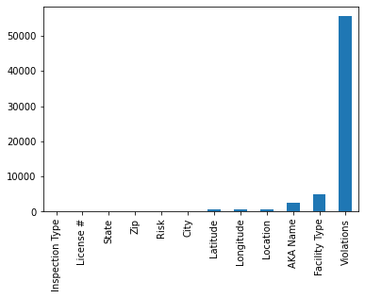
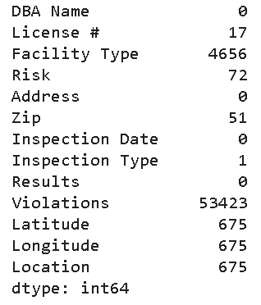
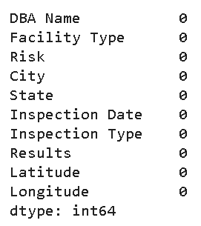
Data cleaning
Verifying data to remove duplicate information, correct existing errors, and provide data consistency.
2244 duplicate records were removed.
Unnecessary columns for this analysis were removed, such as Inspection ID, AKA Name.
Missing values treatment
Missing Value
Notes:
Missing data mainly includes the lack of records and the lack of information in a field in the record, both of which will result in inaccurate analysis results. As shown below, there are a lot of missing values in this data set.
Before performing data analysis, we must deal with missing values. We can use the method of deleting the tuple, that is, deleting the object (tuple, record) with the missing attribute value, so as to get a complete information table.

Slide 7
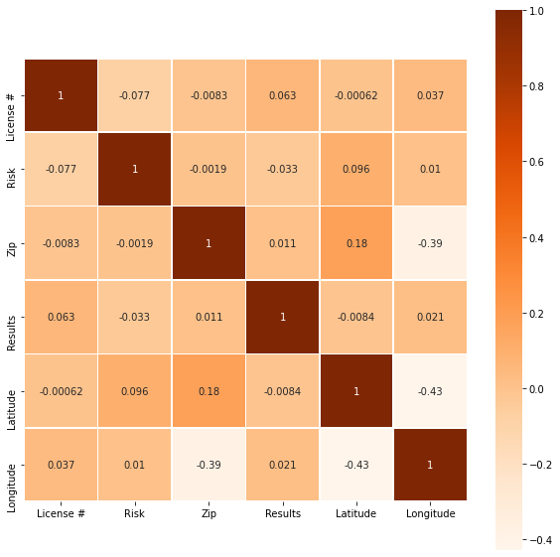
Visualization of Correlations
Using correlation matrix to determine parameters which is the best correlate to each other. If the relationship between the elements on the correlation matrix can be quantified by data, the results can be collated and analyzed more accurately. According to the correlation matrix results, the correlation matrix indicates that ‘Longitude’, ‘Latitude’ have a positive correlation relationship with Risk and Risk also has negative relationship with Results.

Slide 8
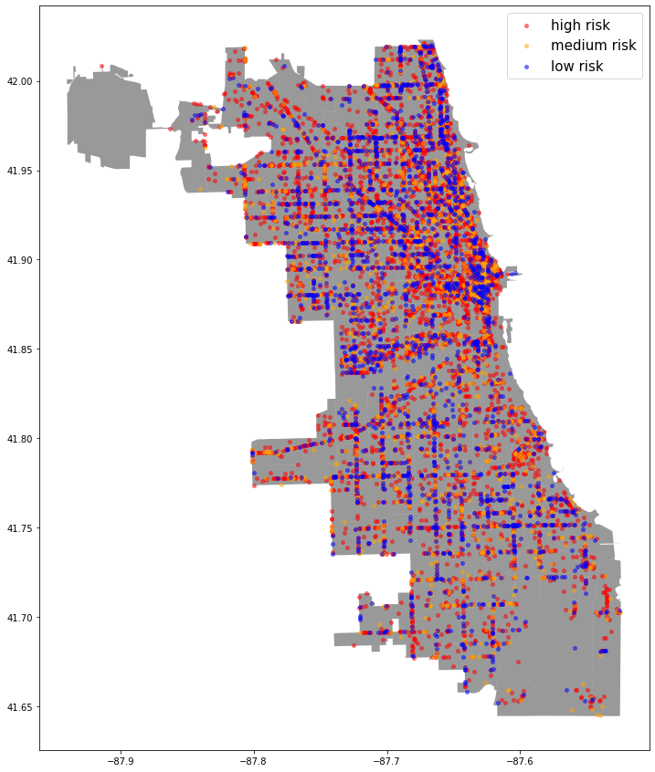
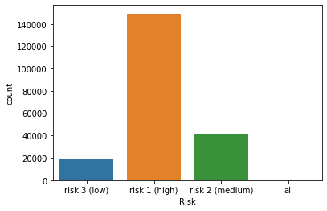
EXPLORATORY DATA ANALYSIS
From the below figure, it can be seen that There are a lot of facilities with High Risk. The percentage of Risk 1 is 40% higher than Risk 2 and Risk 3.

Slide 9
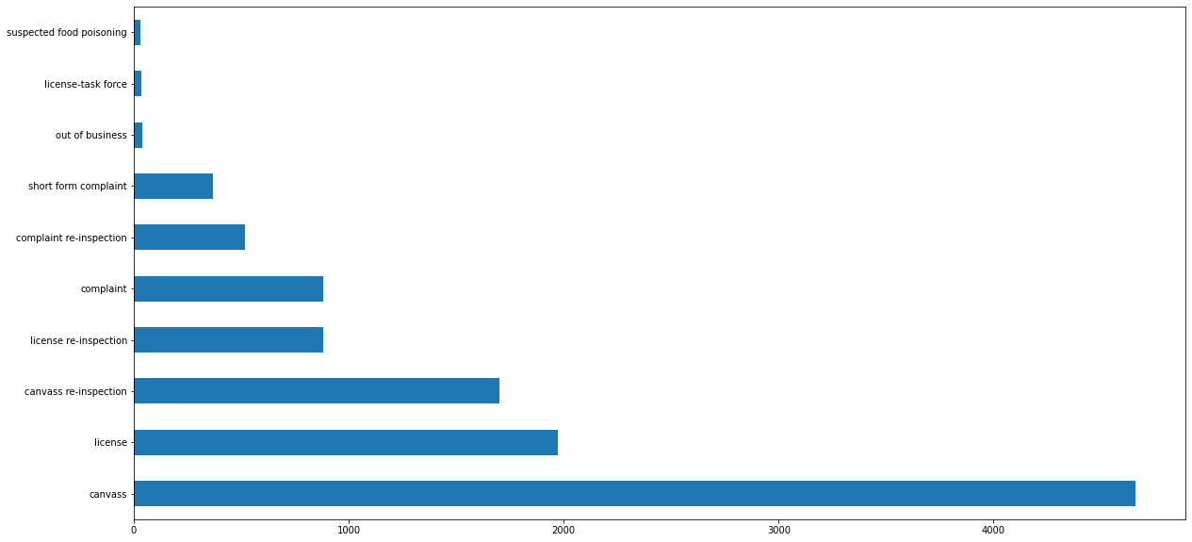
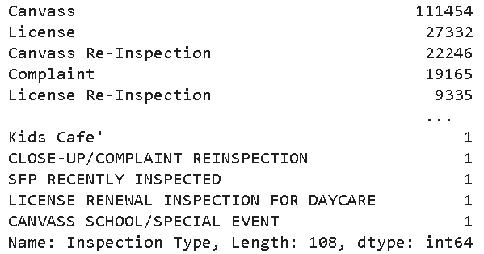
EXPLORATORY DATA ANALYSIS
This bar graph demonstrates that the types of inspection and the corresponding count of inspection. I plot the top 10 inspection types and we can see that Canvass inspection was the most significant type of inspections.

Slide 10
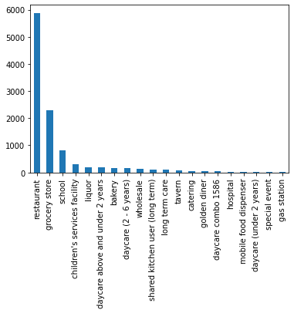
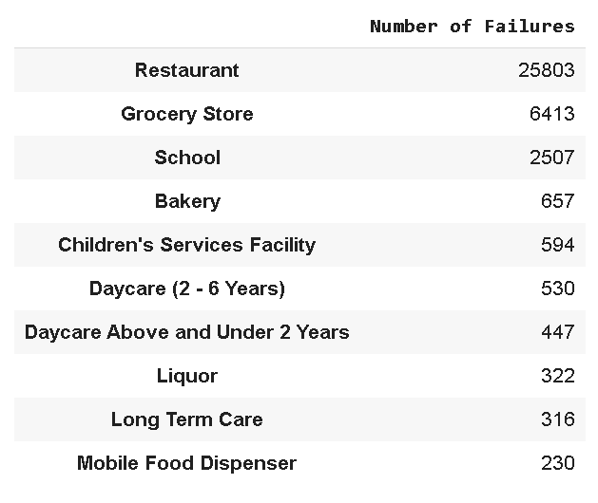
EXPLORATORY DATA ANALYSIS
We can observe that majority of the inspection were in restaurant , grocery store and school.
Based on the analysis, we can see that 'Restaurant' has the highest number of failures.

Slide 11
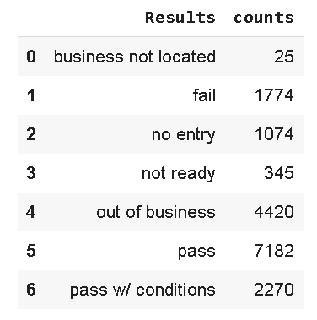
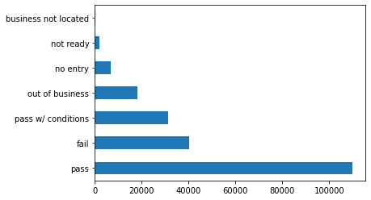
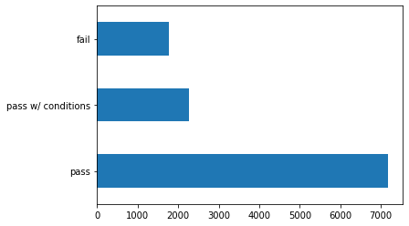
Results analysis
In this case, we can see that there are 5 categories of ‘results’. Over 50% of food facilities got a 'pass'. and 20% (over 35 thousand) got to a 'fail'. There are almost 12% of food facilities also pass with conditions.
However, There are some facilities are not open or place is not ready for inspection. Therefore, I only choose ‘pass’, ‘pass with the condition’ and ‘fail’ for analysis.

Slide 12
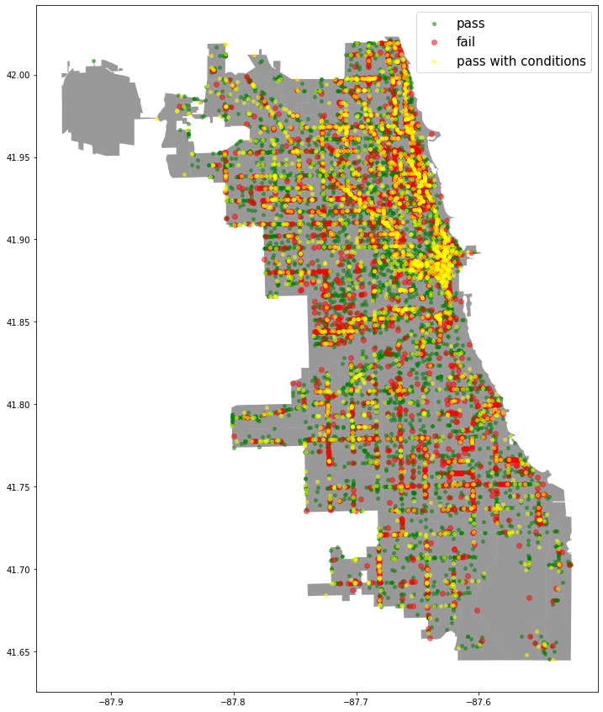
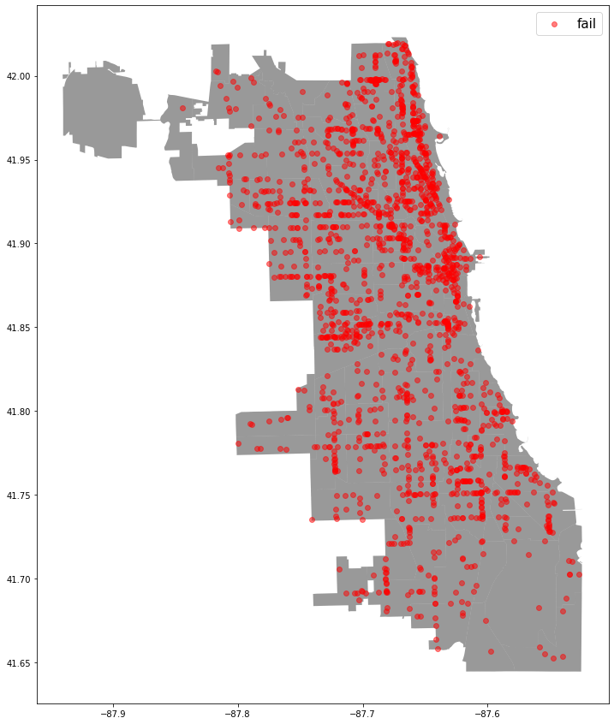
Results analysis
The map shows that each dot represents the inspection at that address, and each red dot represents the number of failed inspections in the area where the facilities is located.
Each red dot shows us where each failure occurred. Therefore, We should pay more attention on this area.

Slide 13
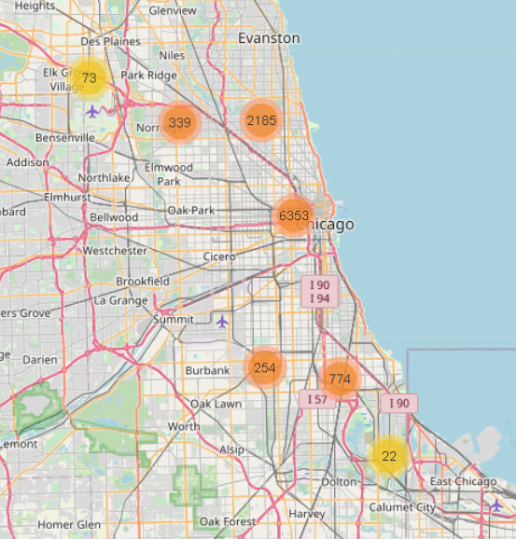
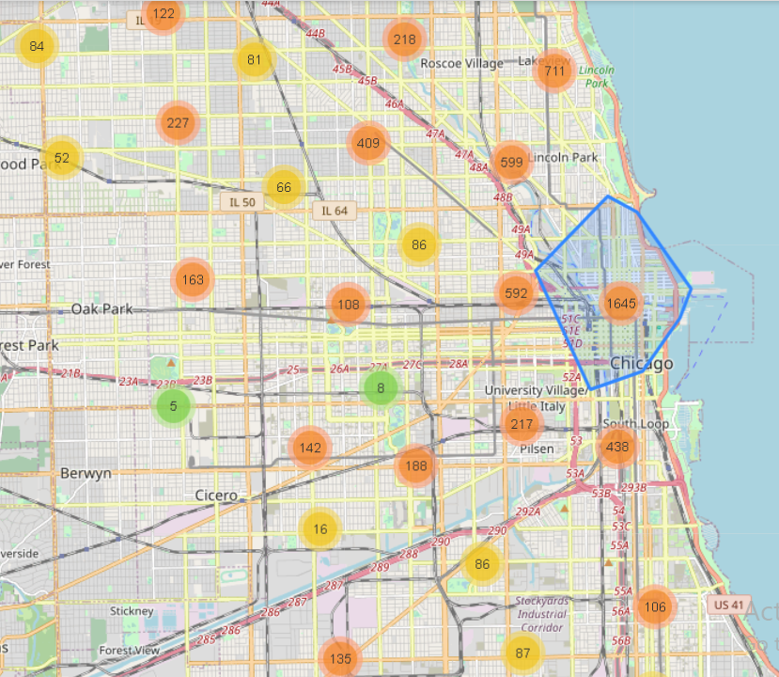
High risk AND location
According to the data analysis of the risk, it is displayed on the Chicago map, which shows us the regional distribution of the risk. Most of the red data points(high risk facilities) are located in the eastern part of Chicago, which indicates that most of the high-risk facilities will be concentrated in the East District, so this is also a region that needs to be focused on.

Slide 14
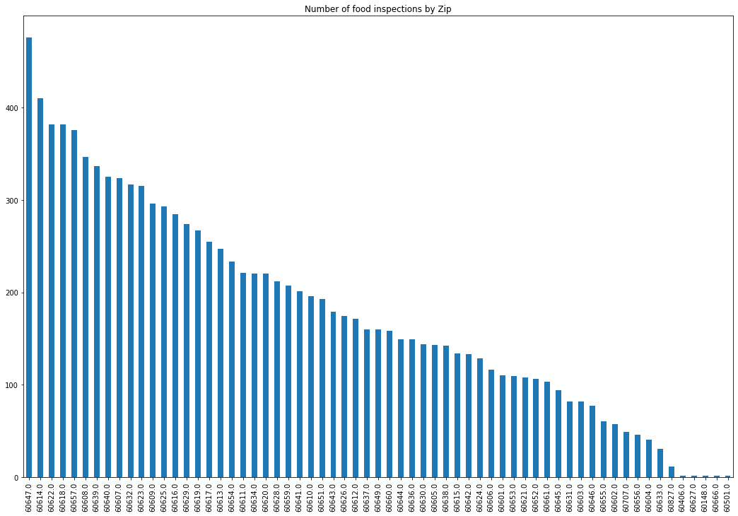
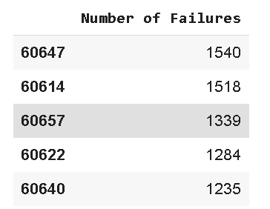
Zip analysis
The above table shows the top 5 zip codes when counting the number of failures. Zip 60647 had the maximum failed number of inspection.

Slide 15
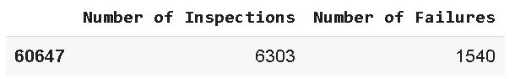
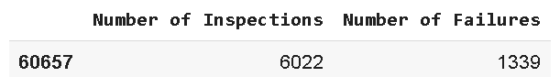
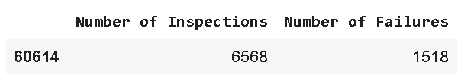
Hypothesis testing
Determine the Hypothesis Statement
Ho: Zip code 60647 is correlated with Fail inspeciton
Ha: Zip code 60647 is not correlated with Fail inspeciton
P value : 2.2174
Ho: Zip code 60657 is correlated with Fail inspeciton
Ha: Zip code 60657 is not correlated with Fail inspeciton
P value : 0.5255
Ho: Zip code 60614 is correlated with Fail inspeciton
Ha: Zip code 60614 is not correlated with Fail inspeciton
p value : 0.0509
∵ P–Value > 0.05 (the α value)
∴ Accept the null hypothesis and reject the alternative hypothesis which state that 60647, 60657, 60614 zip code have correlation with Fail inspection.

Slide 16
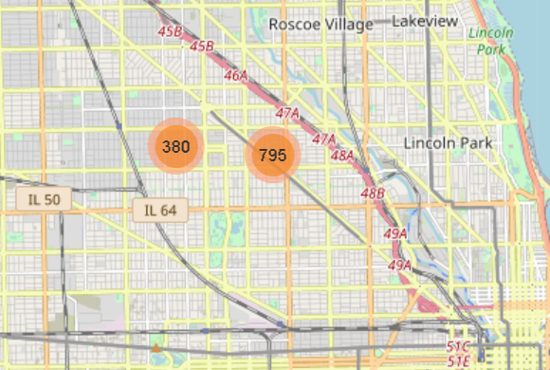
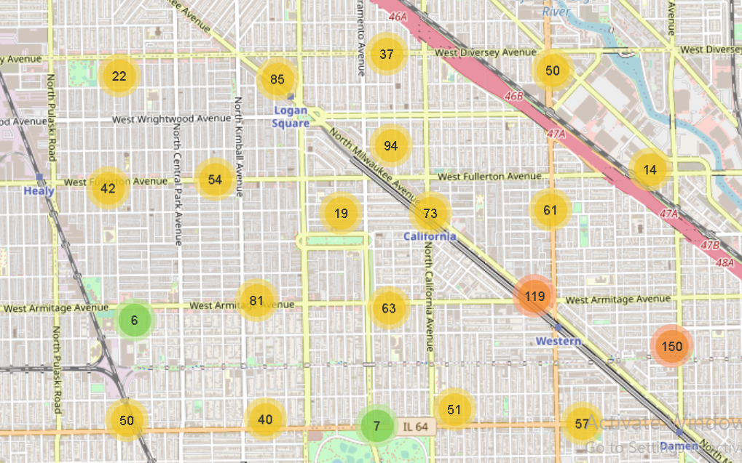
Zip Analysis - Zip 60647
Risk Level : High Risk
Result : Fail
Zip : 60647
Area: LOGAN SQUARE

Slide 17
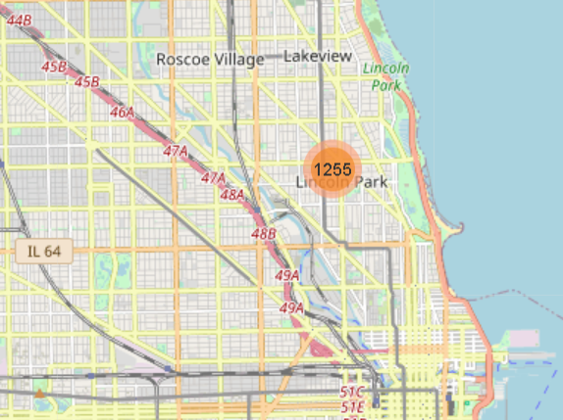
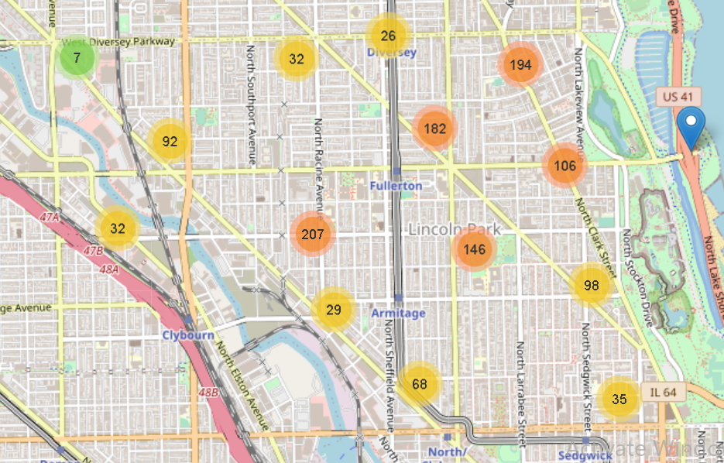
Zip analysis Zip 60614
Risk Level : High Risk
Result : Fail
Zip : 60614
Area: LINCOLN PARK, SHEFFIELD NEIGHBORS, RANCH TRIANGLE

Slide 18
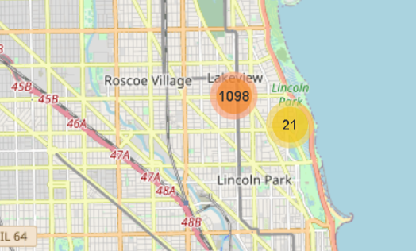
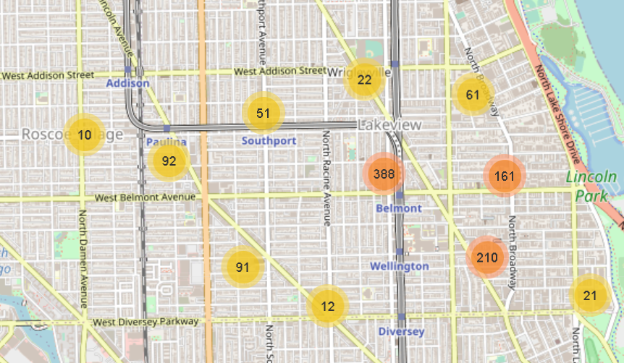
Zip analysis Zip 60657
Risk Level : High Risk
Result : Fail
Zip : 60657
Area: LAKE VIEW & LAKE VIEW EST

Slide 19
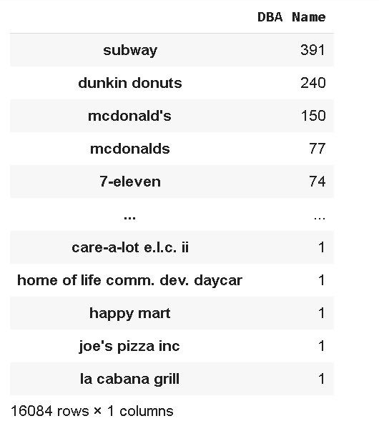



failed inspection & RESTAURANT
Subway, Dunkin Donuts and McDonalds have most failed inspections. Subway chain failed maximum number of inspections and the same can be observed from the table.

Slide 20

CONCLUSION & suggestion
Based on my data analysis, Food Inspection Agency needs to focus on some areas such as LOGAN SQUARE, LINCOLN PARK, SHEFFIELD NEIGHBORS, RANCH TRIANGLE. Those areas have a high probability of violating features. In addition, Some restaurants such as Subway, Dunkin Donuts, and McDonald's restaurants also require regular inspections.
The analysis based on the data gave us a clear idea of ​​how to conduct food inspections in Chicago, and these violations provided good insights. The main goal of this data analysis is to help improve the quality, health, and efficiency of food produced in the Chicago area. My future research is to collect more data and then combine different data sets to build a machine learning model to make predictions. The primary focus remains on using data science to promote efficient, healthy, and sustainable food systems.

Slide 21

THANK YOU

